Slide 1
SEQUENTIAL CIRCUIT
SR LATCH (NOR)

Slide 2
Youtube
https://www.youtube.com/watch?v=OnS7H4pu9rc

Slide 3
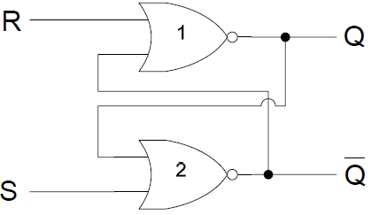
SR L ATCH

Slide 4
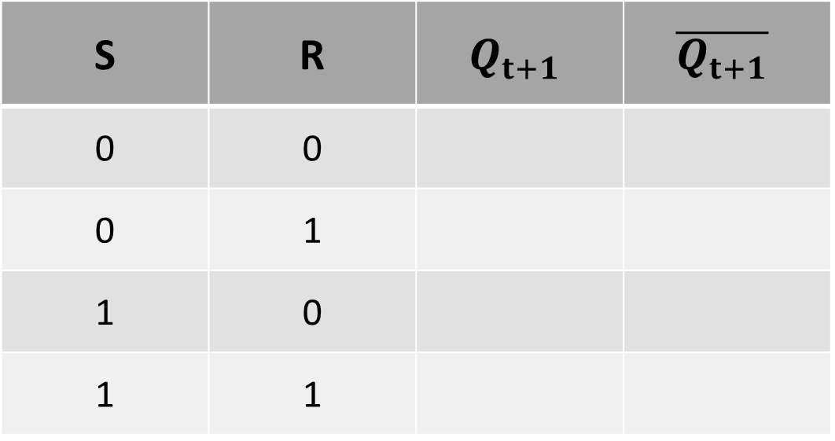
SR LATCH TABLE
S | R | $$Q_{t+1}$$ | $$\overline{Q_{t+1}}$$
0 | 0
0 | 1
1 | 0
1 | 1

Slide 5
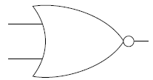
SR L ATCH
A | B | F
0 | 0 | 1
0 | 1 | 0
1 | 0 | 0
1 | 1 | 0

Slide 6
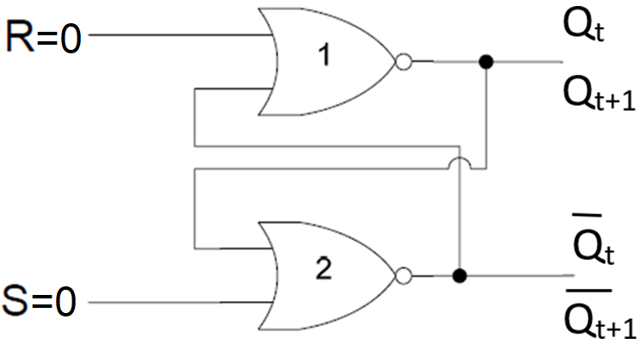
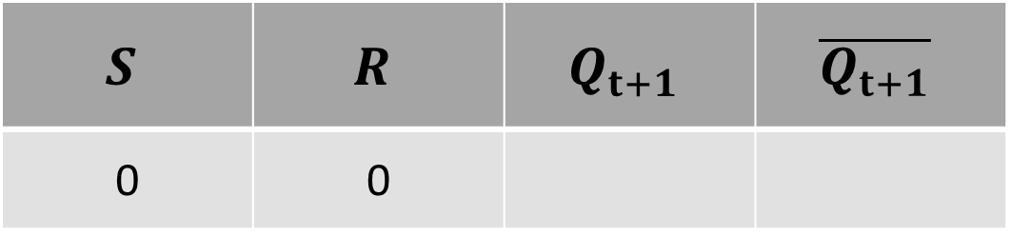
SR L ATCH
$$S$$ | $$R$$ | $$Q_{t+1}$$ | $$\overline{Q_{t+1}}$$
0 | 0

Slide 7
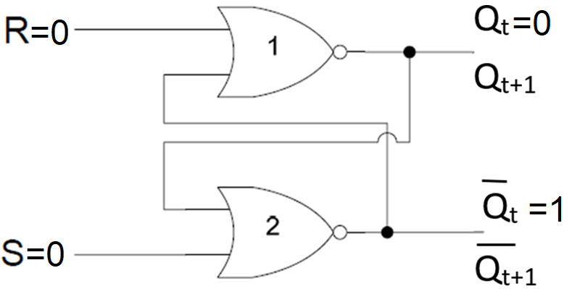
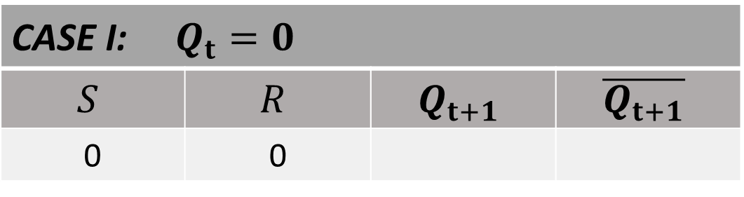
SR L ATCH
CASE I: $Q_{t}=0$
$$S$$ | $$R$$ | $$Q_{t+1}$$ | $$\overline{Q_{t+1}}$$
0 | 0

Slide 8
SR L ATCH
CASE I: $Q_{t}=0$
$$S$$ | $$R$$ | $$Q_{t+1}$$ | $$\overline{Q_{t+1}}$$
0 | 0
0
0
=0
0
=1
1

Slide 9
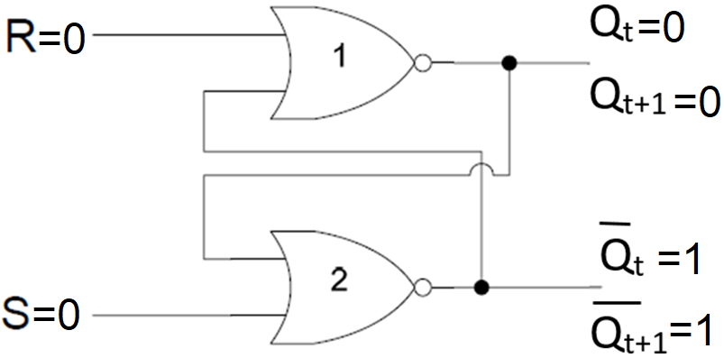
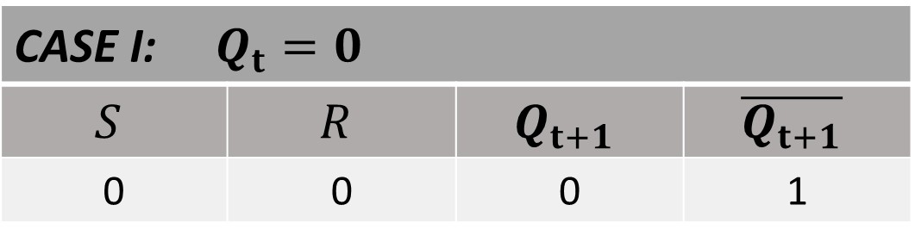
SR L ATCH
CASE I: $Q_{t}=0$
$$S$$ | $$R$$ | $$Q_{t+1}$$ | $$\overline{Q_{t+1}}$$
0 | 0 | 0 | 1

Slide 10
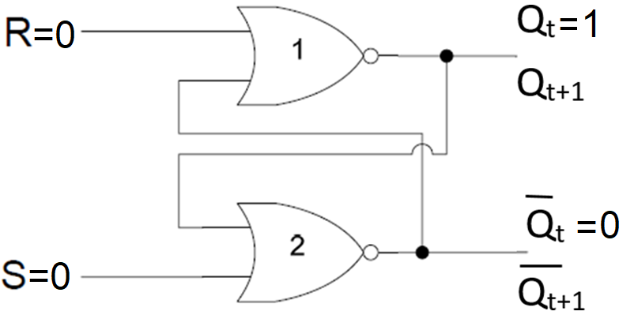
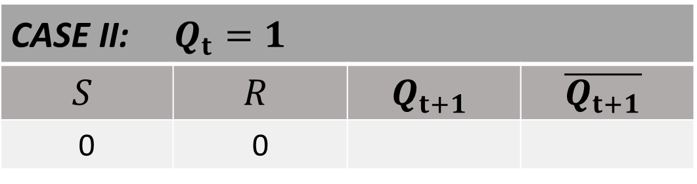
SR L ATCH
CASE II: $Q_{t}=1$
$$S$$ | $$R$$ | $$Q_{t+1}$$ | $$\overline{Q_{t+1}}$$
0 | 0

Slide 11
SR L ATCH
CASE II: $Q_{t}=1$
$$S$$ | $$R$$ | $$Q_{t+1}$$ | $$\overline{Q_{t+1}}$$
0 | 0
1
0
0
0

Slide 12
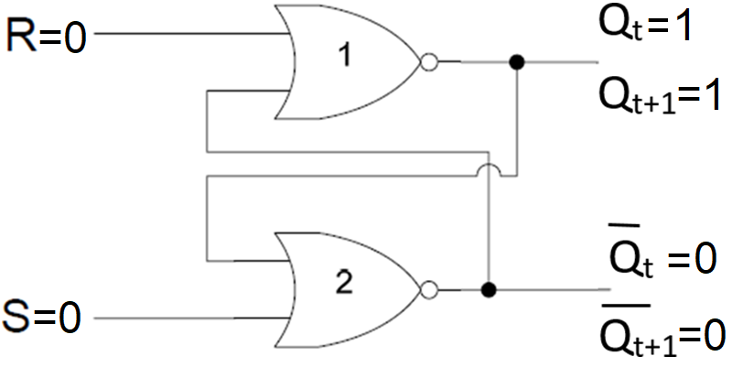
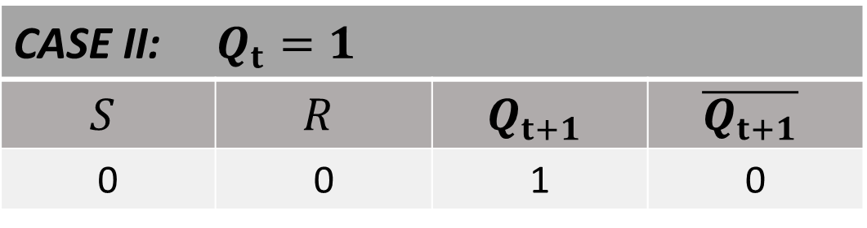
SR L ATCH
CASE II: $Q_{t}=1$
$$S$$ | $$R$$ | $$Q_{t+1}$$ | $$\overline{Q_{t+1}}$$
0 | 0 | 1 | 0

Slide 13
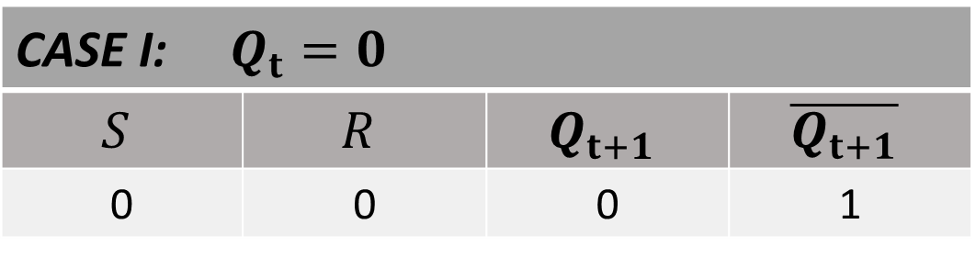
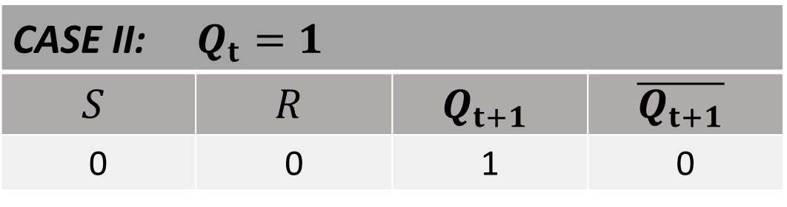
SR L ATCH
CASE I: $Q_{t}=0$
$$S$$ | $$R$$ | $$Q_{t+1}$$ | $$\overline{Q_{t+1}}$$
0 | 0 | 0 | 1
CASE II: $Q_{t}=1$
$$S$$ | $$R$$ | $$Q_{t+1}$$ | $$\overline{Q_{t+1}}$$
0 | 0 | 1 | 0

Slide 14
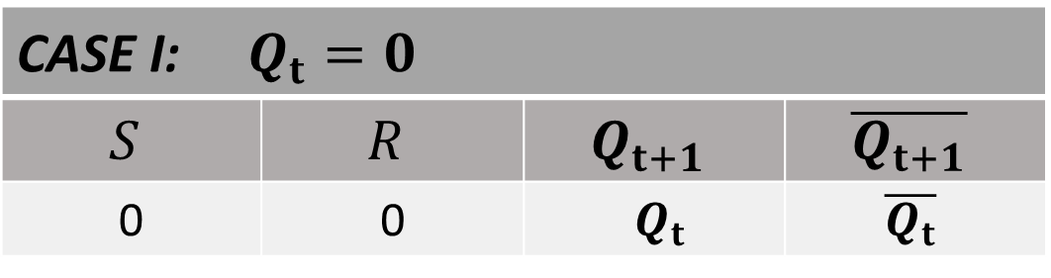
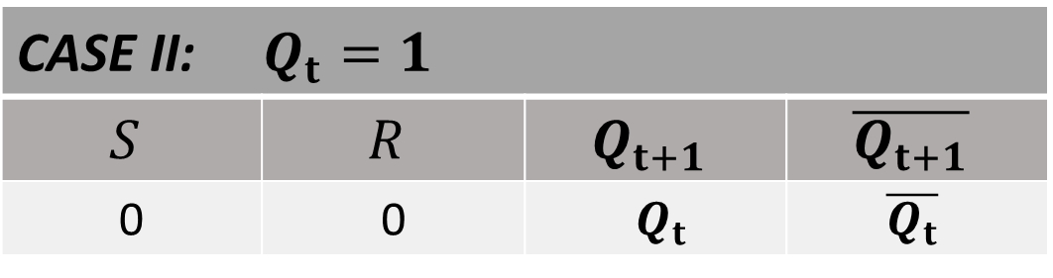
SR L ATCH
CASE I: $Q_{t}=0$
$$S$$ | $$R$$ | $$Q_{t+1}$$ | $$\overline{Q_{t+1}}$$
0 | 0 | $Q_{t}$ | $$\overline{Q_{t}}$$
CASE II: $Q_{t}=1$
$$S$$ | $$R$$ | $$Q_{t+1}$$ | $$\overline{Q_{t+1}}$$
0 | 0 | $Q_{t}$ | $$\overline{Q_{t}}$$

Slide 15
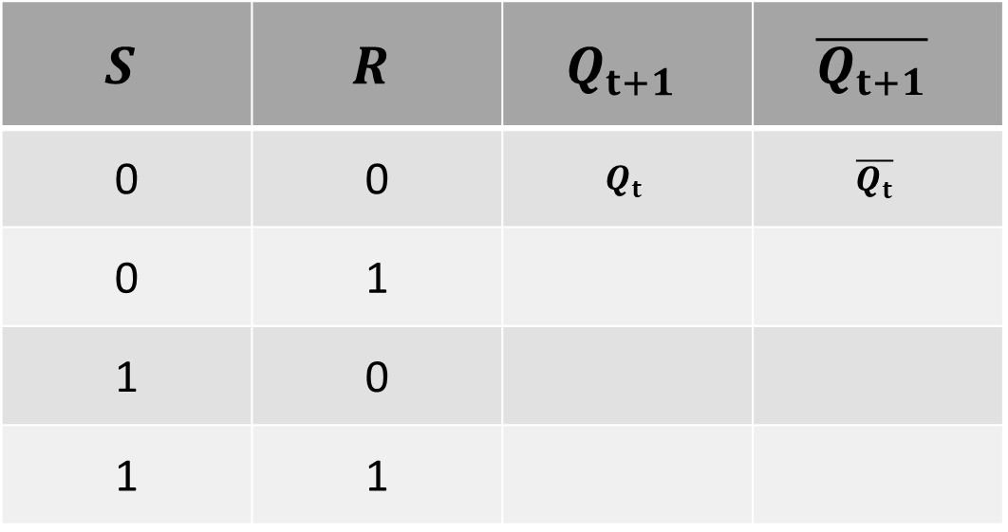
SR LATCH TABLE
$$S$$ | $$R$$ | $$Q_{t+1}$$ | $$\overline{Q_{t+1}}$$
0 | 0 | $$Q_{t}$$ | $$\overline{Q_{t}}$$
0 | 1
1 | 0
1 | 1

Slide 16
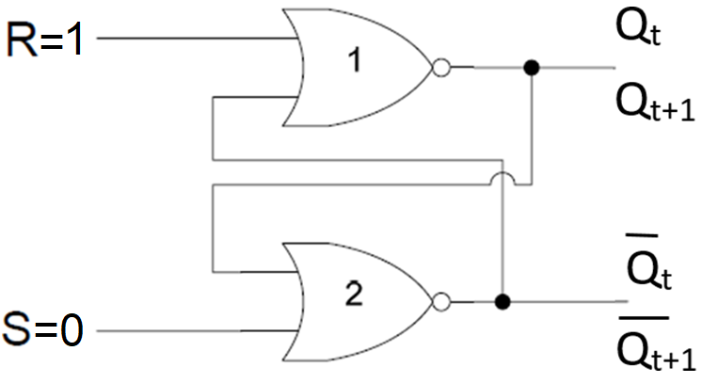
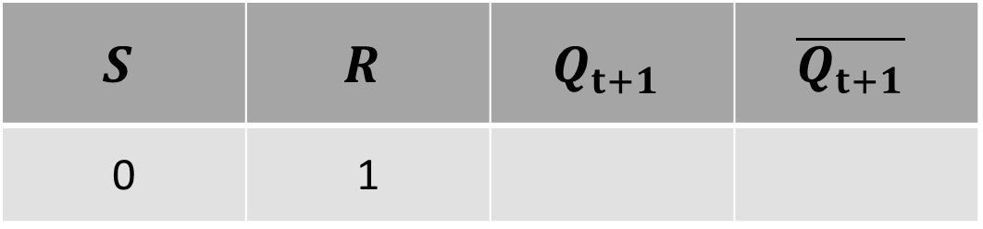
SR L ATCH
$$S$$ | $$R$$ | $$Q_{t+1}$$ | $$\overline{Q_{t+1}}$$
0 | 1

Slide 17
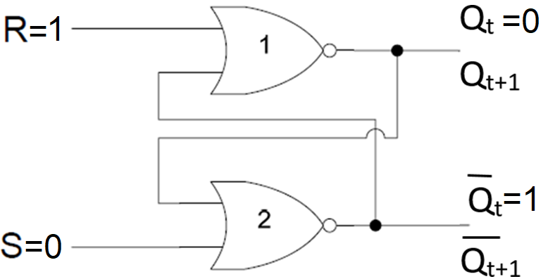

SR L ATCH
CASE I: $Q_{t}=0$
$$S$$ | $$R$$ | $$Q_{t+1}$$ | $$\overline{Q_{t+1}}$$
0 | 1

Slide 18
SR L ATCH
CASE I: $Q_{t}=0$
$$S$$ | $$R$$ | $$Q_{t+1}$$ | $$\overline{Q_{t+1}}$$
0 | 1
1
0
1

Slide 19
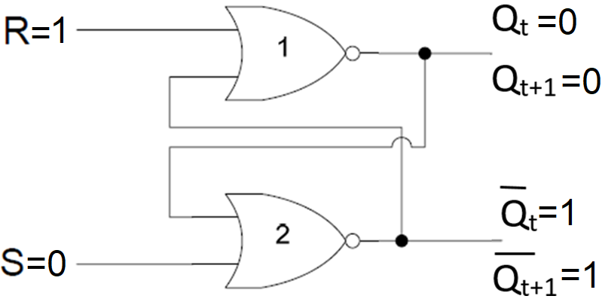
SR L ATCH
CASE I: $Q_{t}=0$
$$S$$ | $$R$$ | $$Q_{t+1}$$ | $$\overline{Q_{t+1}}$$
0 | 1

Slide 20
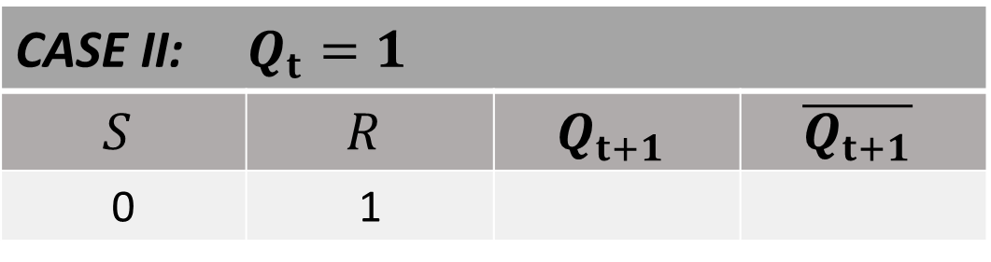
SR L ATCH
CASE II: $Q_{t}=1$
$$S$$ | $$R$$ | $$Q_{t+1}$$ | $$\overline{Q_{t+1}}$$
0 | 1

Slide 21
SR L ATCH
CASE II: $Q_{t}=1$
$$S$$ | $$R$$ | $$Q_{t+1}$$ | $$\overline{Q_{t+1}}$$
0 | 1
1
0
1

Slide 22
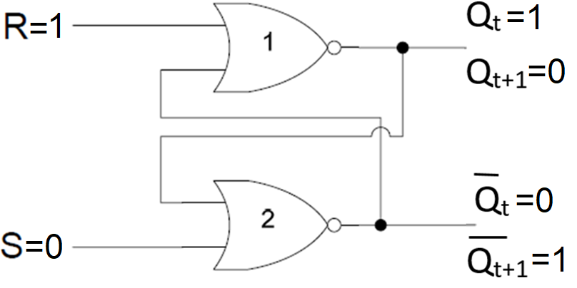
SR L ATCH
CASE II: $Q_{t}=1$
$$S$$ | $$R$$ | $$Q_{t+1}$$ | $$\overline{Q_{t+1}}$$
0 | 1

Slide 23
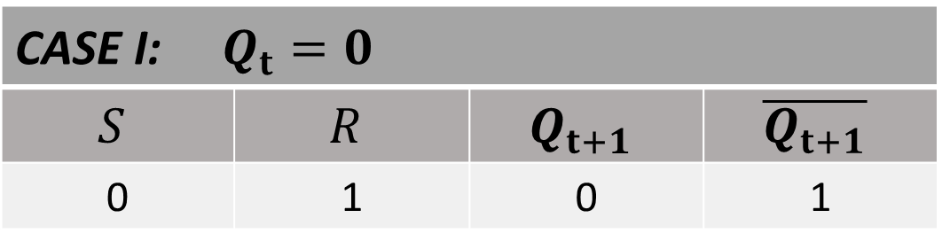
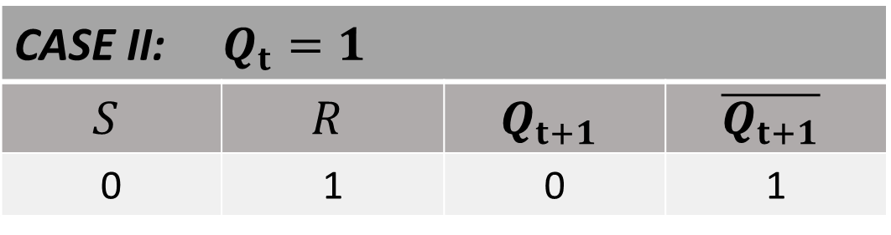
SR L ATCH
CASE I: $Q_{t}=0$
$$S$$ | $$R$$ | $$Q_{t+1}$$ | $$\overline{Q_{t+1}}$$
0 | 1 | 0 | 1
CASE II: $Q_{t}=1$
$$S$$ | $$R$$ | $$Q_{t+1}$$ | $$\overline{Q_{t+1}}$$
0 | 1 | 0 | 1

Slide 24
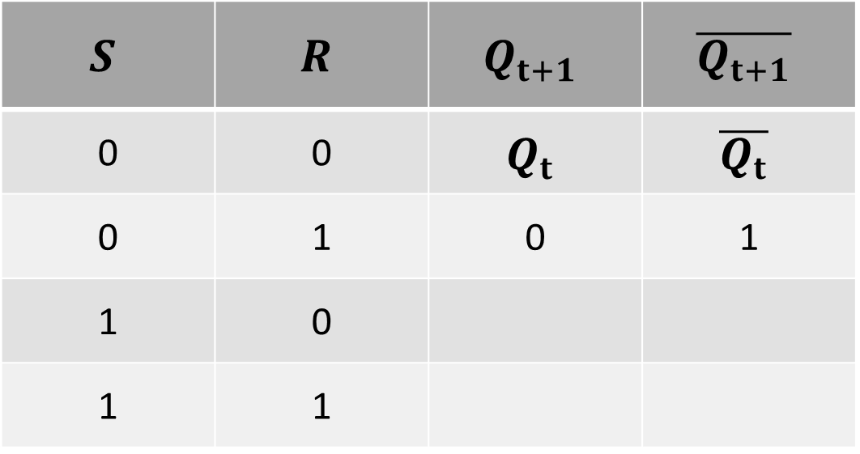
SR LATCH TABLE
$$S$$ | $$R$$ | $$Q_{t+1}$$ | $$\overline{Q_{t+1}}$$
0 | 0 | $$Q_{t}$$ | $$\overline{Q_{t}}$$
0 | 1 | 0 | 1
1 | 0
1 | 1

Slide 25
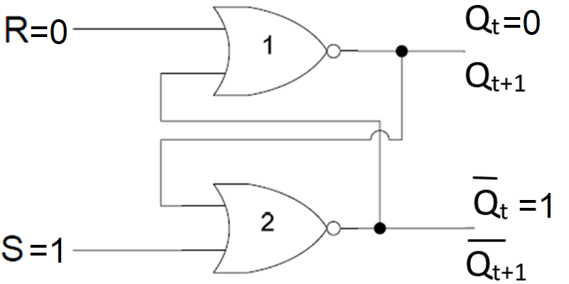

SR L ATCH
CASE I: $Q_{t}=0$
$$S$$ | $$R$$ | $$Q_{t+1}$$ | $$\overline{Q_{t+1}}$$
1 | 0

Slide 26
SR L ATCH
CASE I: $Q_{t}=0$
$$S$$ | $$R$$ | $$Q_{t+1}$$ | $$\overline{Q_{t+1}}$$
1 | 0
1
1
0

Slide 27
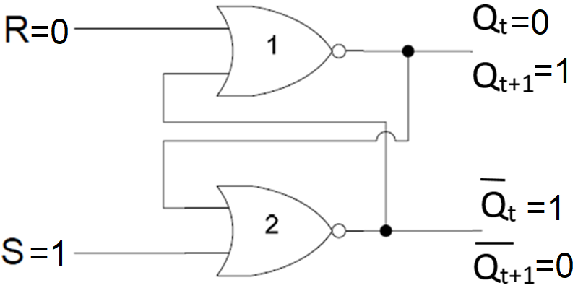

SR L ATCH
CASE I: $Q_{t}=0$
$$S$$ | $$R$$ | $$Q_{t+1}$$ | $$\overline{Q_{t+1}}$$
1 | 0 | 0 | 1

Slide 28
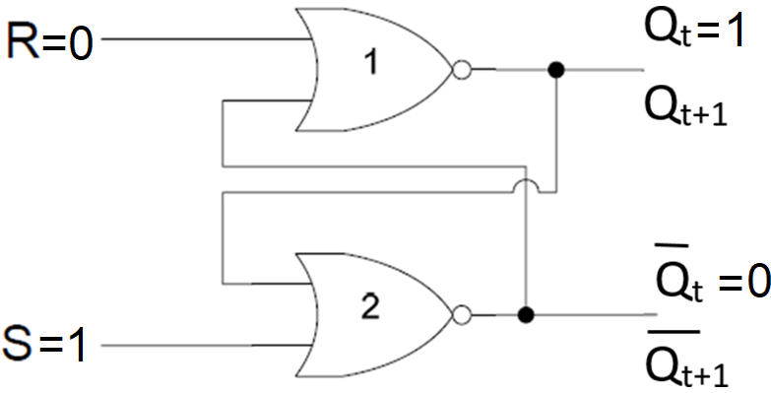

SR L ATCH
CASE II: $Q_{t}=1$
$$S$$ | $$R$$ | $$Q_{t+1}$$ | $$\overline{Q_{t+1}}$$
1 | 0

Slide 29
SR L ATCH
CASE II: $Q_{t}=1$
$$S$$ | $$R$$ | $$Q_{t+1}$$ | $$\overline{Q_{t+1}}$$
1 | 0
1
1
0

Slide 30
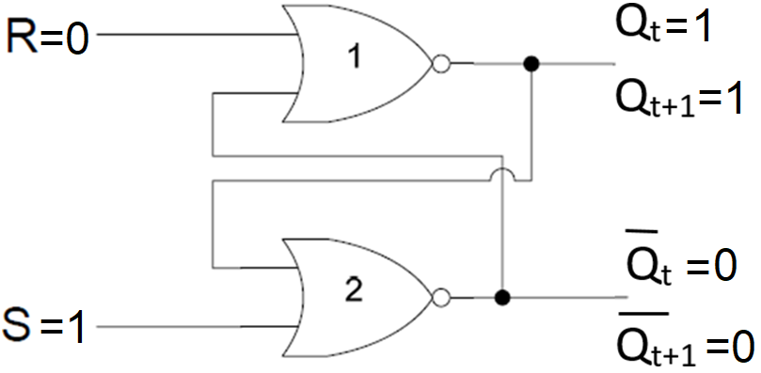

SR L ATCH
CASE II: $Q_{t}=1$
$$S$$ | $$R$$ | $$Q_{t+1}$$ | $$\overline{Q_{t+1}}$$
1 | 0 | 1 | 0

Slide 31
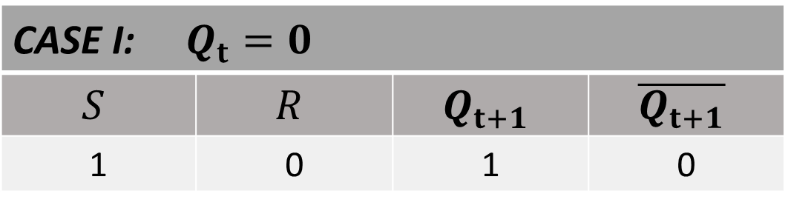

SR L ATCH
CASE I: $Q_{t}=0$
$$S$$ | $$R$$ | $$Q_{t+1}$$ | $$\overline{Q_{t+1}}$$
1 | 0 | 1 | 0
CASE II: $Q_{t}=1$
$$S$$ | $$R$$ | $$Q_{t+1}$$ | $$\overline{Q_{t+1}}$$
1 | 0 | 1 | 0

Slide 32
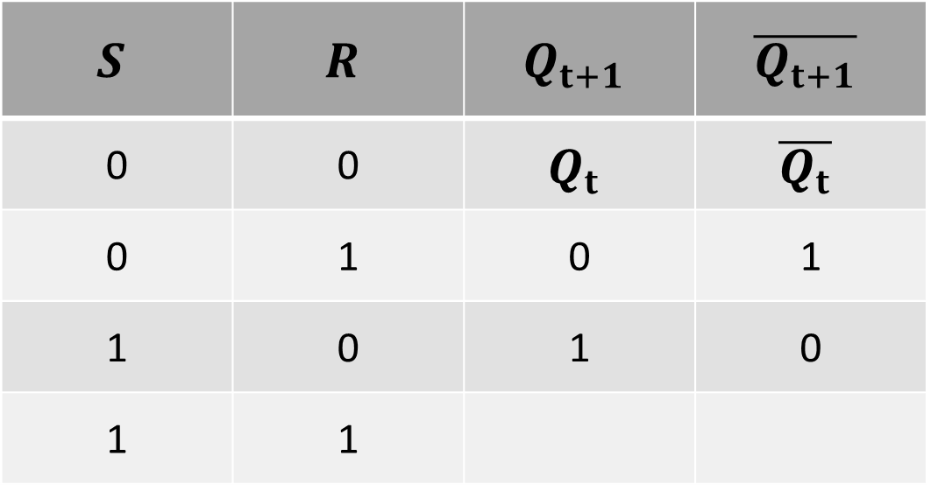
SR LATCH TABLE
$$S$$ | $$R$$ | $$Q_{t+1}$$ | $$\overline{Q_{t+1}}$$
0 | 0 | $$Q_{t}$$ | $$\overline{Q_{t}}$$
0 | 1 | 0 | 1
1 | 0 | 1 | 0
1 | 1

Slide 33
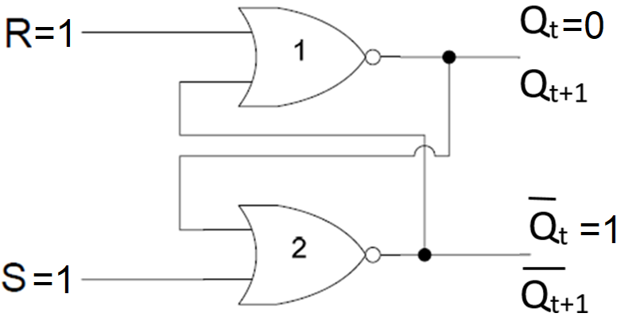

SR L ATCH
CASE I: $Q_{t}=0$
$$S$$ | $$R$$ | $$Q_{t+1}$$ | $$\overline{Q_{t+1}}$$
1 | 1

Slide 34
SR L ATCH
CASE I: $Q_{t}=0$
$$S$$ | $$R$$ | $$Q_{t+1}$$ | $$\overline{Q_{t+1}}$$
1 | 1
1
0
0
1

Slide 35
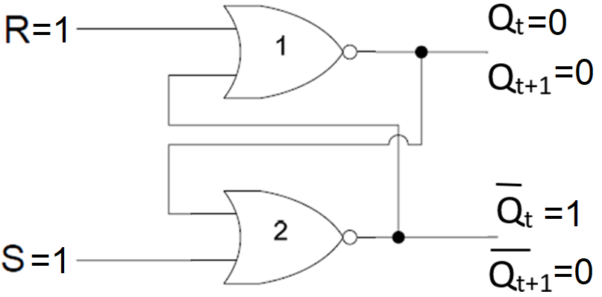

SR L ATCH
CASE I: $Q_{t}=0$
$$S$$ | $$R$$ | $$Q_{t+1}$$ | $$\overline{Q_{t+1}}$$
1 | 1 | 0 | 0

Slide 36


SR L ATCH
CASE II: $Q_{t}=1$
$$S$$ | $$R$$ | $$Q_{t+1}$$ | $$\overline{Q_{t+1}}$$
1 | 1

Slide 37
SR L ATCH
CASE II: $Q_{t}=1$
$$S$$ | $$R$$ | $$Q_{t+1}$$ | $$\overline{Q_{t+1}}$$
1 | 1
1
0
0
1

Slide 38
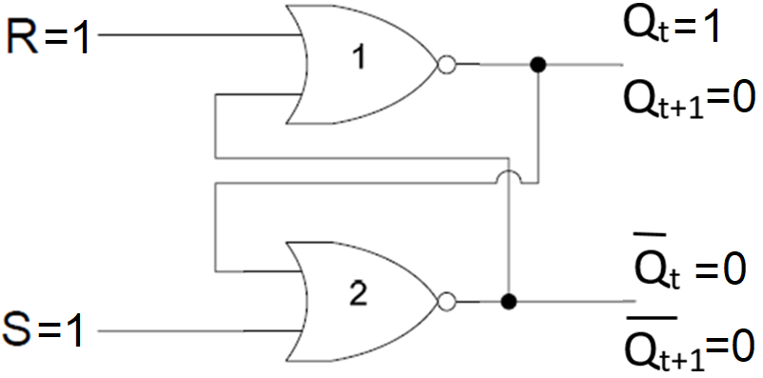
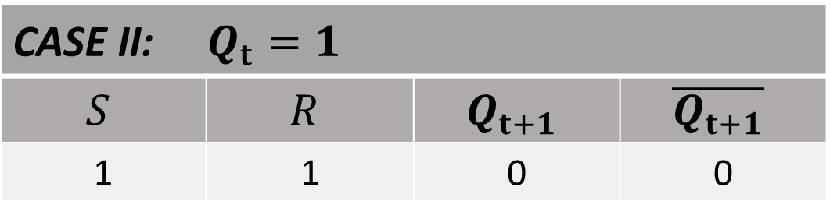
SR L ATCH
CASE II: $Q_{t}=1$
$$S$$ | $$R$$ | $$Q_{t+1}$$ | $$\overline{Q_{t+1}}$$
1 | 1 | 0 | 0

Slide 39
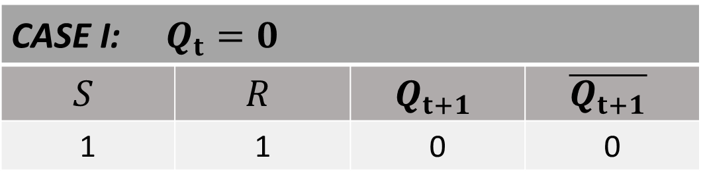
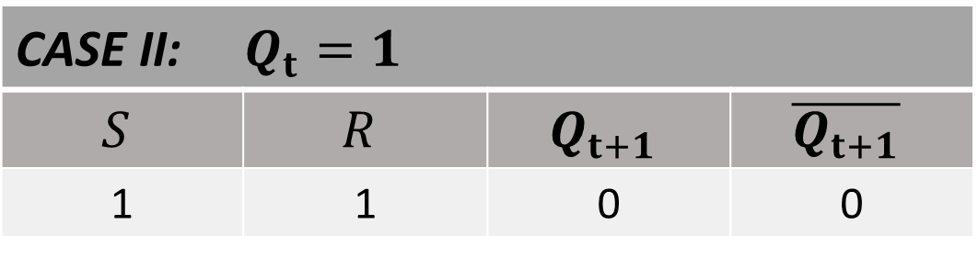
SR L ATCH
CASE I: $Q_{t}=0$
$$S$$ | $$R$$ | $$Q_{t+1}$$ | $$\overline{Q_{t+1}}$$
1 | 1 | 0 | 0
CASE II: $Q_{t}=1$
$$S$$ | $$R$$ | $$Q_{t+1}$$ | $$\overline{Q_{t+1}}$$
1 | 1 | 0 | 0

Slide 40
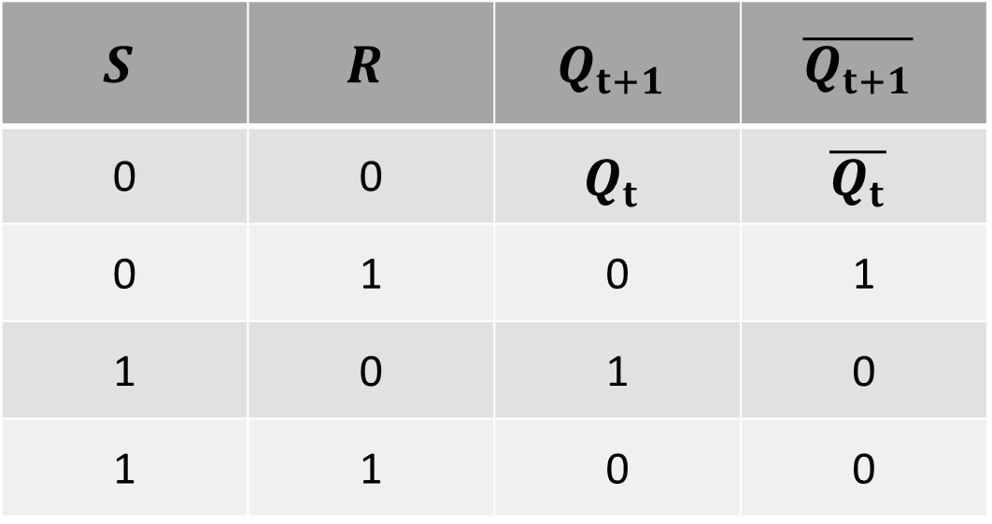
SR LATCH TABLE
$$S$$ | $$R$$ | $$Q_{t+1}$$ | $$\overline{Q_{t+1}}$$
0 | 0 | $$Q_{t}$$ | $$\overline{Q_{t}}$$
0 | 1 | 0 | 1
1 | 0 | 1 | 0
1 | 1 | 0 | 0

Slide 41
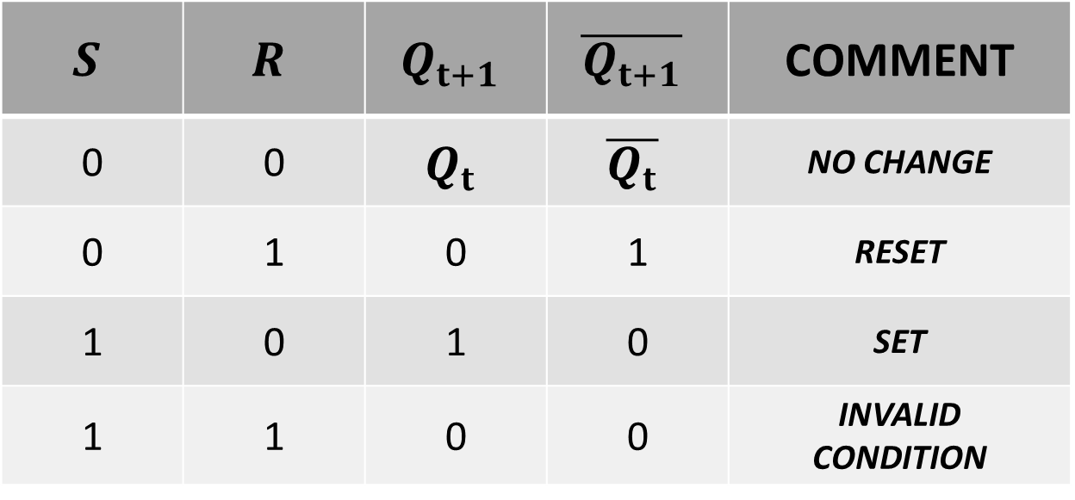
SR LATCH TABLE
$$S$$ | $$R$$ | $$Q_{t+1}$$ | $$\overline{Q_{t+1}}$$ | COMMENT
0 | 0 | $$Q_{t}$$ | $$\overline{Q_{t}}$$ | NO CHANGE
0 | 1 | 0 | 1 | RESET
1 | 0 | 1 | 0 | SET
1 | 1 | 0 | 0 | INVALID CONDITION

